Slide 1
How to collect garbage
when heap memory is running out
The Light of Science (Young Scholars)
-Programming Language Pearls
Ruoyun Tang

Slide 2
行业PPT模板http://www.1ppt.com/hangye/
CONTENTS
CONTENTS
How to collect garbage
when heap memory is running out
01
02
Mark and Sweep Algorithm
Motivation
Reference
Counting
Algorithm
03
04
Conclusion

Slide 3
行业PPT模板http://www.1ppt.com/hangye/
CONTENTS
How to collect garbage
when heap memory is running out
01
02
Mark and Sweep Algorithm
Motivation
Reference
Counting
Algorithm
03
04
Brief Conclusion

Slide 4
Motivation
How to collect garbage when heap memory is running out
D
A
T
A
D
A
T
A
D
A
T
A
D
A
T
A
D
A
T
A
D
A
T
A
Heap Memory
Allocated Heap Memory

Slide 5
Motivation
How to collect garbage when heap memory is running out
D
A
T
A
D
A
T
A
D
A
T
A
D
A
T
A
D
A
T
A
D
A
T
A
Heap Memory
Allocated Heap Memory
Too much data - not infinite capacity
Heap memory running out!!!
OutOfMemory Error
int *p=(int *)malloc(sizeof(int));
⬇ new data which needs heap memory
D
A
T
A
D
A
T
A
D
A
T
A
D
A
T
A
D
A
T
A
D
A
T
A
......

Slide 6



Motivation
How to collect garbage when heap memory is running out
?

Slide 7
Motivation
How to collect garbage when heap memory is running out
Collect the garbage in our daily life.
?

Slide 8
Motivation
How to collect garbage when heap memory is running out
?
Clear the
GARBAGE
and reuse the space

Slide 9

Motivation
How to collect garbage when heap memory is running out
HOW?
Programmer himself!
WHO knows what is garbage?

Slide 10
Motivation
How to collect garbage when heap memory is running out
D
A
T
A
D
A
T
A
D
A
T
A
D
A
T
A
D
A
T
A
D
A
T
A
Heap Memory
Allocated Heap Memory
int *p=(int *)malloc(sizeof(int));
⬇ new data which needs heap memory
D
A
T
A
D
A
T
A
D
A
T
A
D
A
T
A
D
A
T
A
D
A
T
A
......

Slide 11
Motivation
How to collect garbage when heap memory is running out
D A T A
D
A
T
A
D
A T A
D
A
T
A
D
A
T
A
D
A
T
A
Heap Memory
Allocated Heap Memory
NEW
NEW
(*6)......

Slide 12

Motivation
How to collect garbage when heap memory is running out
Garbage
D
A
T
A
Garbage
D
A
T
A
D
A
T
A
Garbage
Heap Memory
Allocated Heap Memory
TIRED
NEW DELETE
NEW DELETE
NEW DELETE
*∞
......

Slide 13
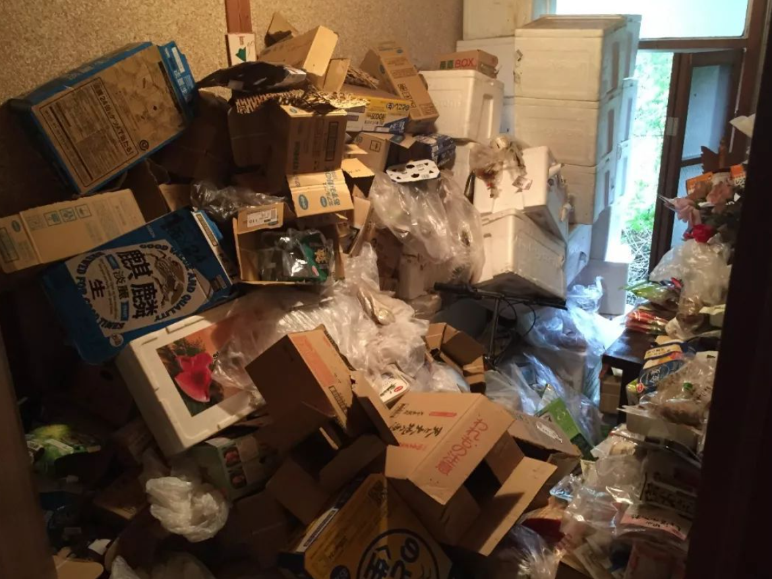
Motivation
How to collect garbage when heap memory is running out
Garbage
D
A
T
A
Garbage
D
A
T
A
D
A
T
A
Garbage
Garbage
Heap Memory
Allocated Heap Memory
Accidentally forget to release it !
Memory
Leakage

Slide 14

Motivation
How to collect garbage when heap memory is running out
Design
some
Algorithms

Slide 15
行业PPT模板http://www.1ppt.com/hangye/
CONTENTS
How to collect garbage
when heap memory is running out
01
02
Mark and Sweep Algorithm
Motivation
Reference
Counting
Algorithm
03
04
Conclusion

Slide 16
Mark and Sweep Algorithm
Principle
Advantages
DIsadvantages
How to collect garbage
when heap memory is running out

Slide 17

Mark and Sweep Algorithm
How to collect garbage when heap memory is running out
John McCarthy
the Father of LISP
raised this algorithm
in 1960（and applied it to LISP)
......many other contributions

Slide 18
Mark and Sweep Algorithm
How to collect garbage when heap memory is running out
Mark Phase
Principle
Sweep Phase

Slide 19
Mark and Sweep Algorithm
How to collect garbage when heap memory is running out
Mark Phase
Mark Phase
Principle
Sweep Phase

Slide 20
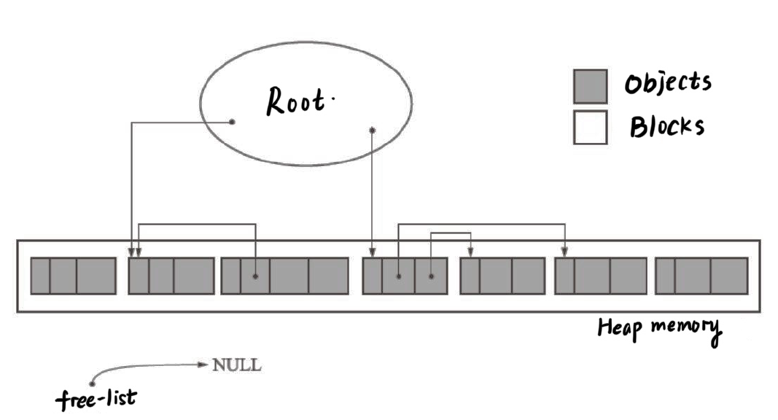
Mark and Sweep Algorithm
How to collect garbage when heap memory is running out
Root
Heap Memory
Free-list
Depth-First Search Approach & Repeated

Slide 21
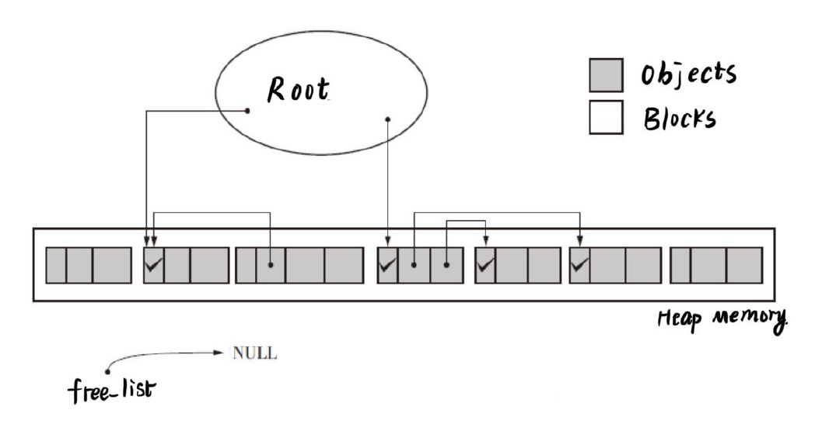
Mark and Sweep Algorithm
How to collect garbage when heap memory is running out
Root
Heap Memory
Free-list
Change the state of the mark bits

Slide 22
Mark and Sweep Algorithm
How to collect garbage when heap memory is running out
Mark Phase
Principle
Sweep Phase
Sweep Phase

Slide 23
Mark and Sweep Algorithm
How to collect garbage when heap memory is running out
Root
✔
✔
✔
✔
Heap Memory
Free-list
Linearly traverse the whole memory

Slide 24
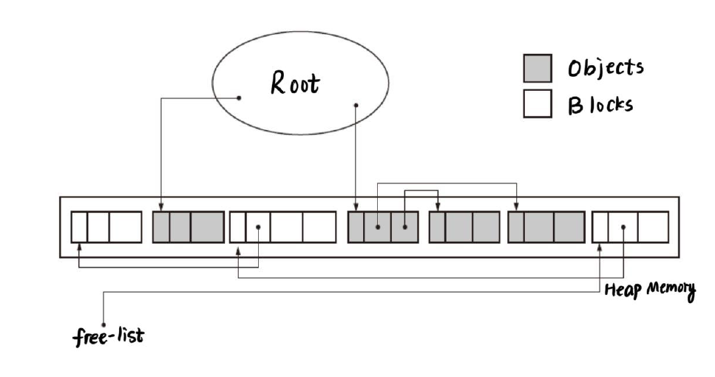
Mark and Sweep Algorithm
How to collect garbage when heap memory is running out
Root
“CLear” the Garbage
Heap Memory
Free-list

Slide 25
Mark and Sweep Algorithm
How to collect garbage when heap memory is running out
Advantages
Simple Logic → Easy to actualize
Disadvantages
1.Low efficiency
suspension & heavy workload
2.Fragmentation
int *p=(int *)malloc(sizeof(int)*3);
D
A
T
A
D
A
T
A
D
A
T
A
D
A
T
A
D
A
T
A
D
A
T
A
D
A
T
A
D
A
T
A
D
A
T
A
Heap Memory

Slide 26
行业PPT模板http://www.1ppt.com/hangye/
CONTENTS
How to collect garbage
when heap memory is running out
01
02
Mark and Sweep Algorithm
Motivation
Reference
Counting
Algorithm
03
04
Conclusion

Slide 27
Reference Counting Algorithm
Principle
Advantages
DIsadvantages
How to collect garbage
when heap memory is running out

Slide 28
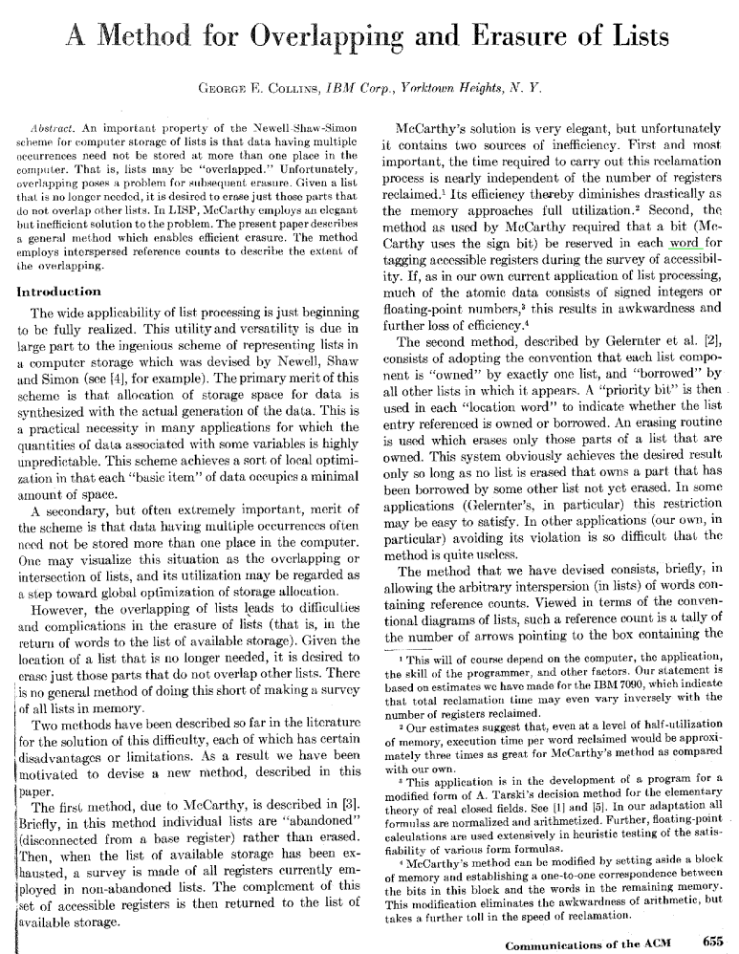
Reference Counting Algorithm
How to collect garbage when heap memory is running out
George E. Collins
raised this algorithm
Harold McBeth
pointed out
the problem of
circular reference
in 1960 too
no photo available
just original dissertation

Slide 29
Reference Counting Algorithm
How to collect garbage when heap memory is running out
Principle
Header
COUNTER
+1
-1
Header

Slide 30
Reference Counting Algorithm
How to collect garbage when heap memory is running out
Principle
Header
COUNTER
==0
Free_list
COllECTED!

Slide 31
Mark and Sweep Algorithm
How to collect garbage when heap memory is running out
Principle
Header
COUNTER
==0
Header
Header
COUNTER
-1
COUNTER
-1
When? ALL circumstances that will change the counter.
- A new object is created
- The pointer is renewed

Slide 32
Reference Counting Algorithm
How to collect garbage when heap memory is running out
Advantages
1. collect the garbage immediately
2. more efficient ( suspension & start node )
1. Circular reference
2. Space for Counter
3. Low efficiency
when keeping renewing pointers
Disadvantages
A
B

Slide 33
行业PPT模板http://www.1ppt.com/hangye/
CONTENTS
How to collect garbage
when heap memory is running out
01
02
Mark and Sweep Algorithm
Motivation
Reference
Counting
Algorithm
03
04
Conclusion

Slide 34
Conclusion
How to collect garbage when heap memory is running out
find the garbage
Two main problems
Prepare for reallocating

Slide 35
Conclusion
How to collect garbage when heap memory is running out
√ More efficient
√ Occupy less space
√ Convenient for
reallocating the heap memory
Faster Higher Stronger :)
Future Development?

Slide 36
Please don’t ask me questions!
Thanks for your attention
How to collect garbage
when heap memory is running out
Ruoyun Tang

